Slide 1
Office Hours
Presented By: Group 1
Revanth Vallamsetty
Ashok Atkuri
Varshitha Guntakandla
Swathi Dasari

Slide 2
Contents
Problem statement
Functional Requirements
Non Functional Requirements
Tools and Technologies
Architecture plan
Demo
Future Scope
Conclusion

Slide 3
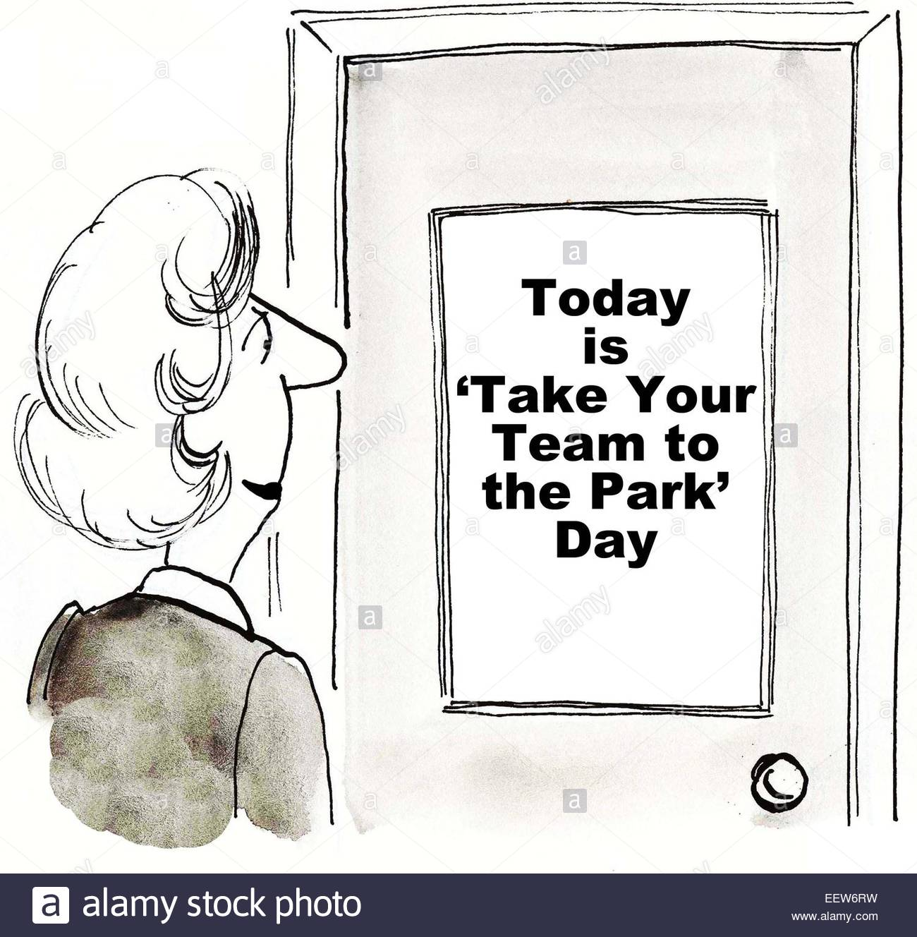
Problem Statement
Schedule of advisor changes constantly
Updating them by sticking paper
reference
Notes:
Prepared By : Swathi Dasari
Day to day scheduling and updating is a repetitive process for a university professor. The main problem occurs when the schedule of the advisor changes, they notify the changes by sticking the printed paper on the door. Sometimes the paper may fall and the messages don't reach the students in time. If you take northwest university as an example , professors notify their office hours and even their absence by sticking the paper on the door.

Slide 4
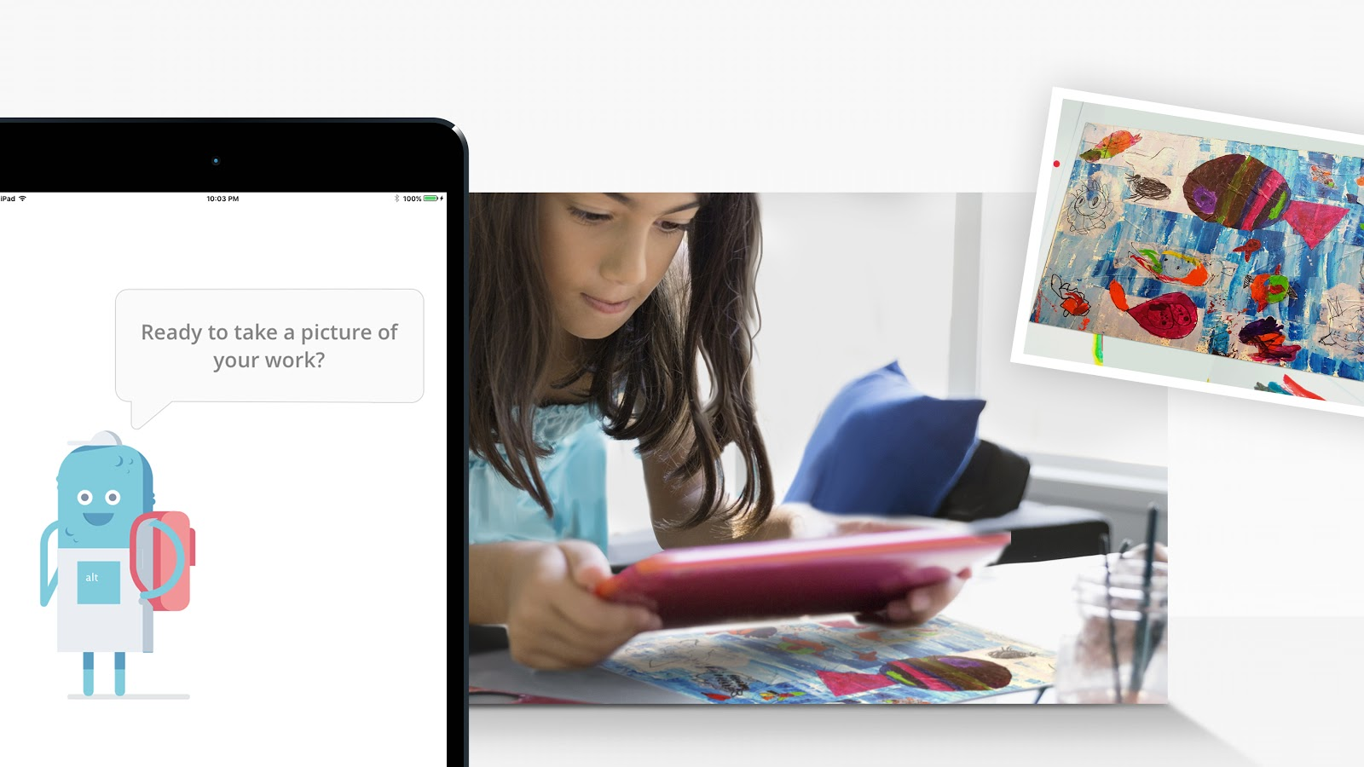
Problem Statement (contd..)
Updating during busy schedules
Scheduling an appointment by the student.
Evaluating the students with paper Drop off.
reference
Notes:
Prepared By: Swathi Dasari
It is very difficult for the professor to update the schedule by sticking the paper on the door during busy times. Sometimes he/she will have health problem and it will be very difficult for them to update their message to the students.

Slide 5
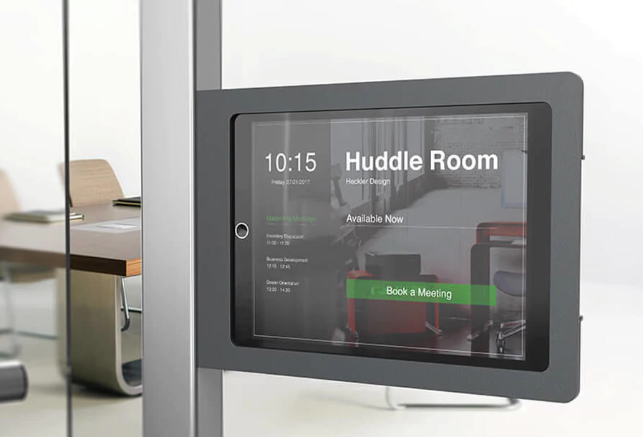
Functional Requirements
Displaying availability
Schedule or office hours
Log in
Appointment booking
Professor unavailable
Taking a picture while submission
Leave a message
reference

Slide 6
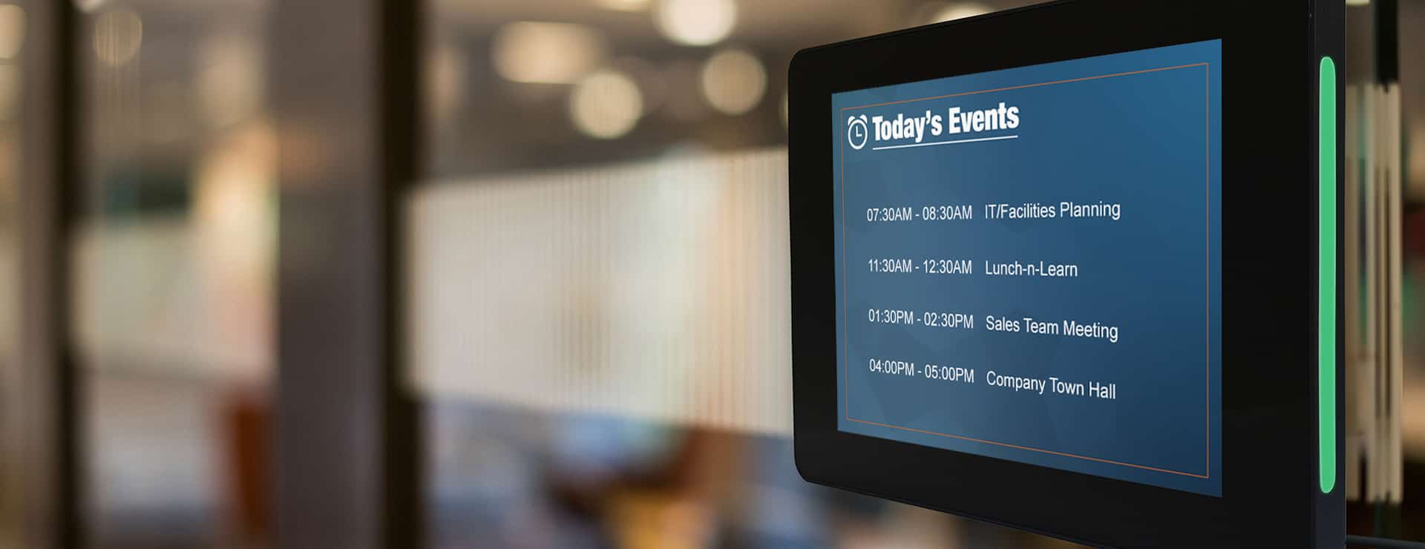
Functional Requirements : ADMIN
Sign up and log in functionalities
Leave a note
Schedule
Notify admin
Updated calendar with all events
Messages
Pictures while submissions
reference
Notes:
Prepared By : Varshitha Guntakandla
in order to provide them we need few things to be done admin side
here are the basic fuctionalities admin side should have
intially a welcome page and descibing about the app
a sign up page when we have a new user, which can be done by providing their
a login option for an already exisiting user
Home page should be displayed once the user is loged in
if a user logged out then it should redirect to logout page

Slide 7
Non-Functional Requirements
Interface -user friendly, meaningful error messages
Performance -stability, fast response
Security -microsoft authentication is used for log in functionalities,
Integrity - sync with outlook calendar
Compatibility- different versions of desktops
Notes:
Interface is designed in a user fiendly manner and any errors should be displayed with a proper message
Performance of the application should be stable and not long time to process the requests.

Slide 8
Tools and Technique
Front- End: HTML, CSS, JavaScript, Bootstrap, .cshtml(Razor Pages), JQuery
Database: Microsoft SQL server
Framework: ASP.NET MVC
Language: C#
Server: IIS

Slide 9
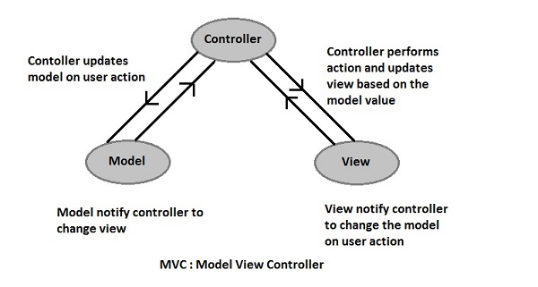
Architecture Plan

Slide 10
Demo
Ashok Atkuri ‹#›

Slide 11
Summary of Requirements completed
Student View:
View faculty schedule
Create Appointment
Capture Notes
Send a message
View status
Faculty View:
View and update Faculty schedule
View student captured notes
View messages by students
View and update status
Can view appointments
Revanth Vallamsetty ‹#›

Slide 12
Summary of Requirements Not completed
Future Scope
The system MUST show the slot as unavailable once an appointment is made at that time.
Adding a video/ audio call to the professor.
Sending application alerts to mobile.
Revanth Vallamsetty ‹#›

Slide 13
Installation Guide
Download and install Microsoft visual studio. Refer the below link:
https://docs.microsoft.com/en-us/visualstudio/install/install-visual-studio?view=vs-2017
Download and install Microsoft SQL server 2017 professional with ssms/management studio . Refer the below link:
https://www.microsoft.com/en-us/sql-server/sql-server-download
Register the sample on the app registration portal.
Create a new app at apps.dev.microsoft.com, or follow these detailed steps. Make sure to Copy down the Application ID assigned to your app, you'll need it soon.
Add the Web platform for your app.
Enter the correct Redirect URI. The redirect uri indicates to Azure AD where authentication responses should be directed - the default is https://localhost:4279/.
Add a new application secret via the "Generate new password", and save the result in a temporary location - you'll need it in the next step.
Revanth Vallamsetty ‹#›

Slide 14
Execution Guide
To get the working files into a local computer, clone the repository.
Repository link: https://github.com/RevanthVallamsetty/GDPOfficeHours
Click the officehours.sln file in visual studio and right click on the project and click on build.
Open the Package manager console present in tools and run below command in console: nuget restore OfficeHours.sln.
Create a Database in SQL server and change the connection string in the Web.config file in the project. Then open the SQL server object explorer and connect to the database you created on the local machine before
.In the web.config file , Find the app key ida:ClientSecret and replace the value with the application secret you saved while installation/registering app in portal..
Then run the application by clicking on the button on the top menu bar labelled IIS express.This runs the app in the local IIS server. App will listen on http://localhost:4279
Revanth Vallamsetty ‹#›

Slide 15
Conclusion
Eases professor tiring work
It provides better communication channel
Good security for the applications
Revanth Vallamsetty
Notes:
This applications eases professors tiring work by making everything online wheater updating his schedule or confirming appointments. With this Professor can effectively communicate with his students and vice-versa. Data is secured in the applications.
We would like to thank Dr. fella for giving this opportunity to work as a team and patrick immel
l for making us work on such a wonderful project.

Slide 16
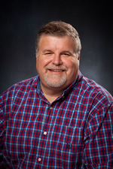
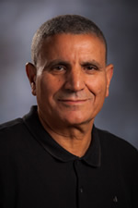
Our Client: Patrick Immel
Our Advisor: Dr. Aziz Fellah
Notes:
Prepared By: Ashok Atkuri

Slide 17

Notes:
Prepared By: Ashok Atkuri

